Slide 1
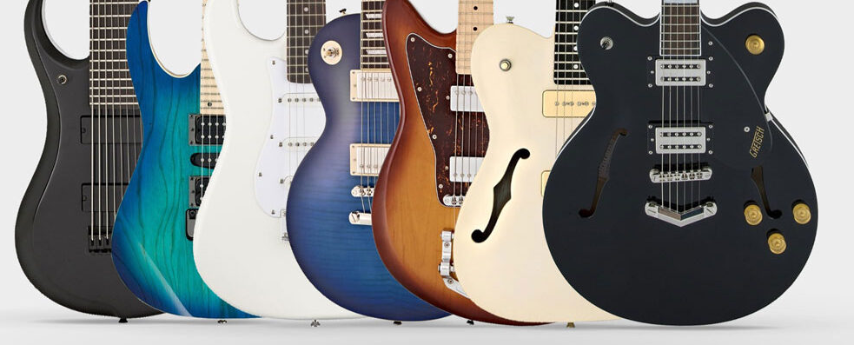
CREATE
YOUR
BUYER’S GUIDE

Slide 2
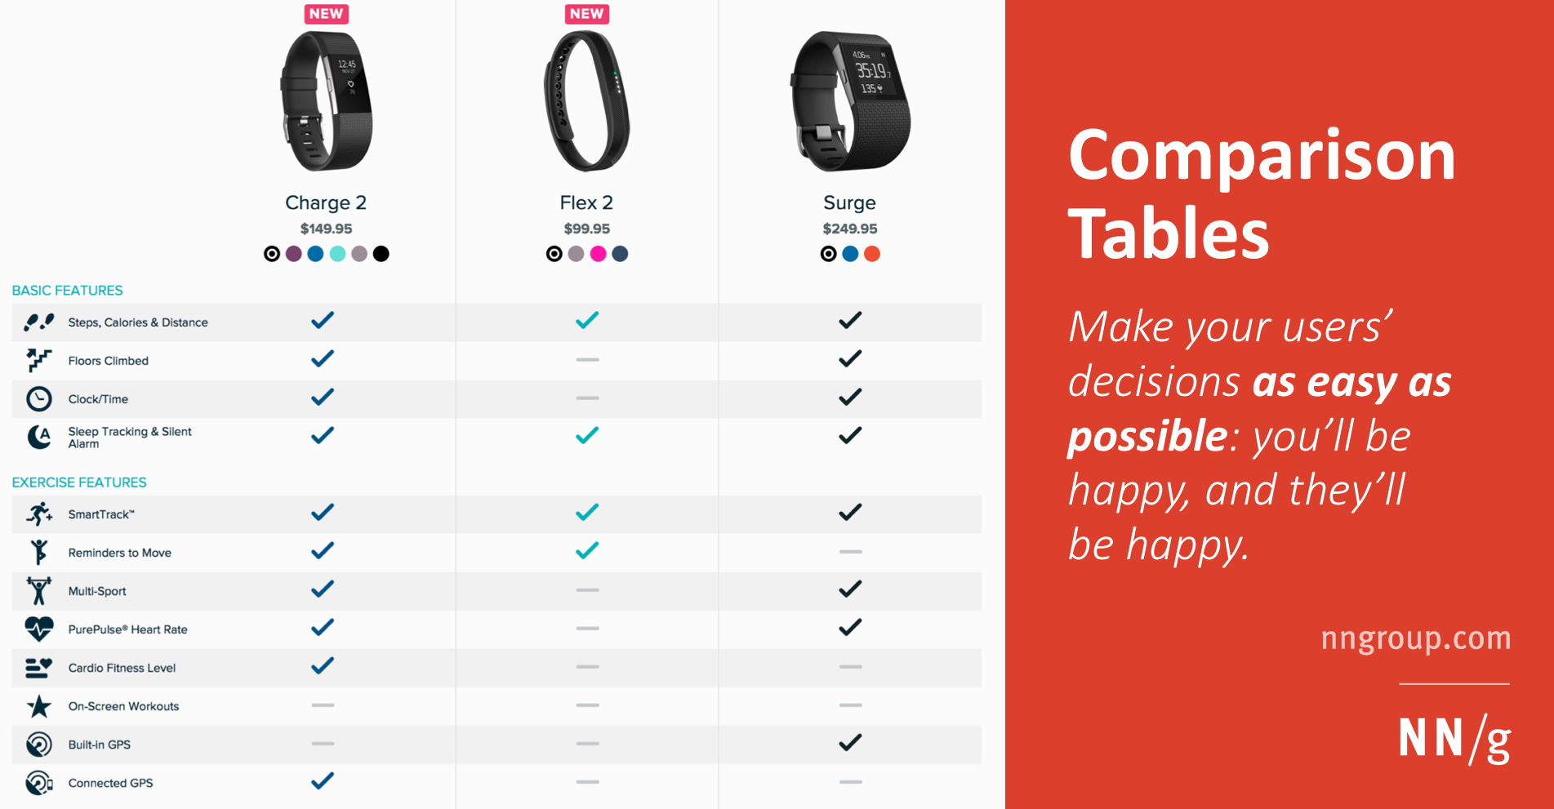
A buyer's guide is a piece of content designed to help customers make a buying decision by providing all the information they need in one place.
Comparison between different products

Slide 3
Your buyer’s guide content
1 - COVER
PAGE
5 - INTERVIEWS
3 - PRODUCTS
PRESENTATION
2 - TABLE OF CONTENT
4 - PRODUCTS
COMPARAISON

Slide 4
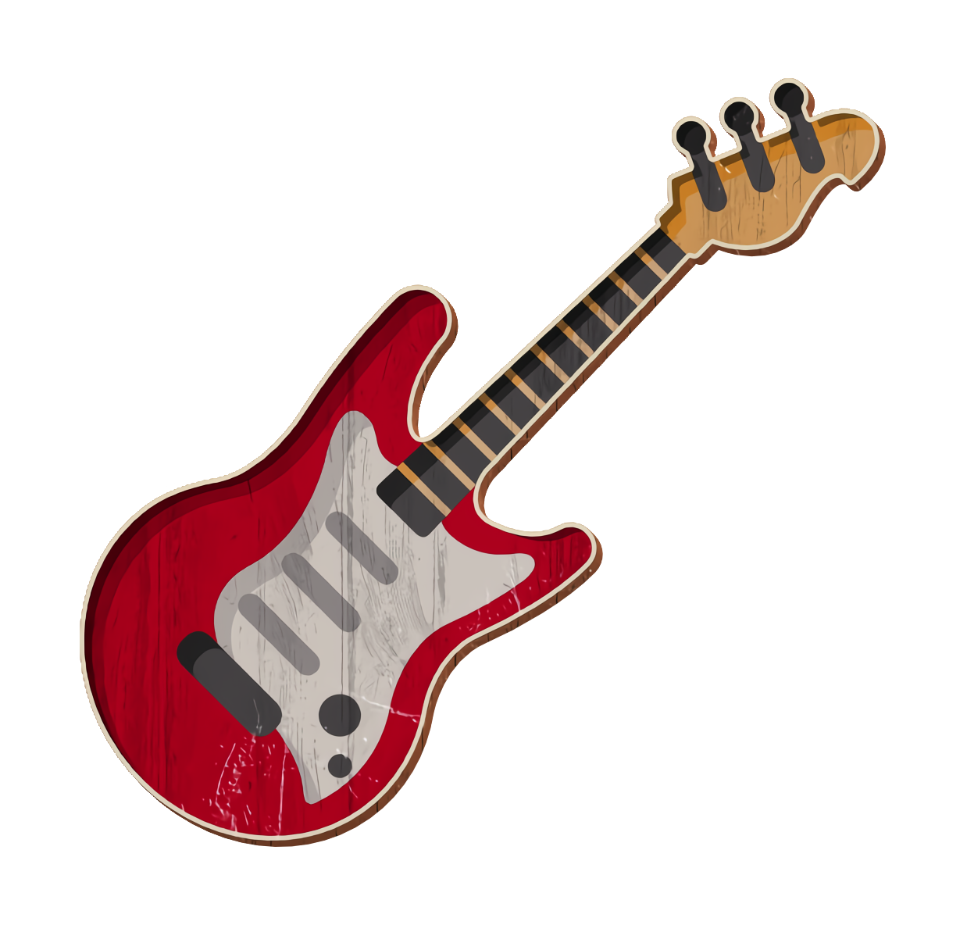

1 - COVER PAGE
2 – TABLE OF CONTENT
Header with your guide title
- MY BUYER GUIDE ON GUITARS -
ELECTRIC
ACOUSTIC
TABLE OF CONTENT
Cover of your guide.
THE FIGHT
The table of content shall be generated automatically
1 - Presentation of the products
1.1 - Acoustic
1.2 - Electric
2 - Which guitar should you buy ?
3 - Let s talk to musicians !
Your name, class
RONAN OGOR – CLASS B
Footer with page number
- PAGE 1 -

Slide 5
3 – PRODUCTS PRESENTATION
- MY BUYER GUIDE ON GUITARS -
1 –Presentation of the products
This page shall have title 1 , title 2
1.1 The electric guitar
Electric guitars are easier to play. The strings are lighter and far more comfortable than acoustic guitars. One key aspect which makes electric guitars so appealing is that they are a lot smaller than acoustic guitars, so it does make learning more comfortable.
1.2 The acoustic guitar
Use a nice layout between text and image to present the 2 items you want to compare
Acoustic guitars are often considered harder to learn. This is due to the strings being heavier and the height of the strings being higher than standard electric guitars.
Your page shall also include some notes, related to your researches
1 - The story of the guitar – 2021 – Rady Y
2 - Why acoustic are so good - 2021 – Rady Y
- PAGE 2 -

Slide 6
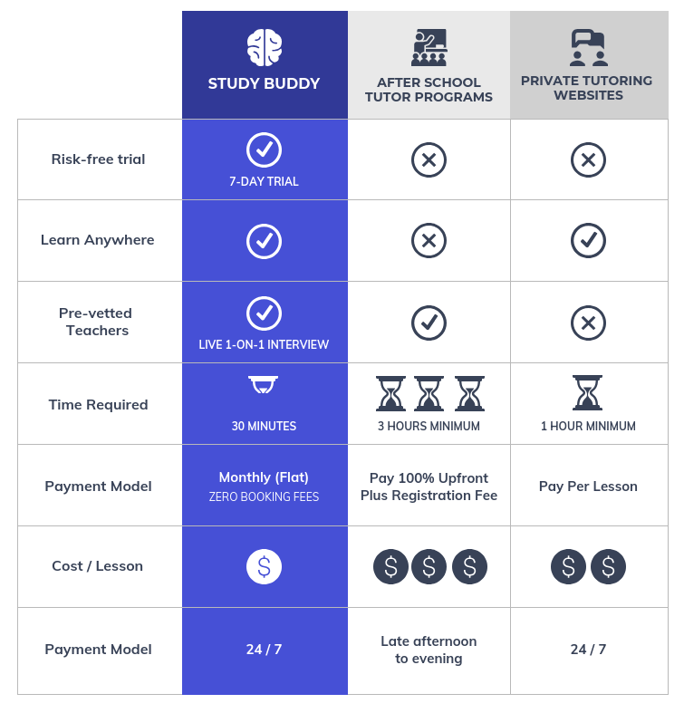
4 – PRODUCTS COMPARAISON
- MY BUYER GUIDE ON GUITARS -
2 – Which guitar should you buy ?
Electric guitars are easier to play. The strings are lighter and far more comfortable than acoustic guitars. One key aspect which makes electric guitars so appealing is that they are a lot smaller than acoustic guitars, so it does make learning more comfortable.
The page shall include a table with many criteria to compare the 2 items
You need to evaluate each items regarding your criteria
Find a way to present your evaluation in a nice way (icons….)
- PAGE 3 -

Slide 7


5 – PRODUCTS INTERVIEW
- MY BUYER GUIDE ON GUITARS -
3 – Let s talk to musicians !
Acoustic guitar is my best friend in my life
Why do you like to play acoustic ?
I like acoustic for my own compositions, as I put a lot of focus on melody and wording. An acoustic guitar travels well, with no supporting equipment
Interview 2 students or teacher about your product
Why I you favorite song you like to play?
Il like playing the song called : Ronan is the best
Because Ronan is my favorite teacher
Find at least 2 questions to ask
Electric guitar is more fun!
Why do you like to play acoustic ?
Find a good style to present well your questions and the answers of your interviewees
I like acoustic for my own compositions, as I put a lot of focus on melody and wording. An acoustic guitar travels well, with no supporting equipment
Why I you favorite song you like to play?
Il like playing the song called : Ronan is the best
Because Ronan is my favorite teacher
- PAGE 4-

Slide 8


Project timeline
MON
MAY 15
MON
MAY 22
Choose the product to compare
Research about the products and perform you interviews
Design your guide ( font, color , titles, margin, table, columns, etc.…)
Write the guide
PRESENTATIONS

Slide 9

Evaluation
This is your evaluation of
MS WORD
MS WORD SKILLS
Header and footer well defined | 5
Same style used for the entire document | 10
Table of content is automatically updated | 5
Good usage of Title1, Title2 …. | 5
Good layout between images and texts | 5
Use of Foot notes | 5
Good table layout to compare the products | 10
Good usage of margins and spaces | 5
OTHER
Good graphic design (alignments, color, font.) | 10
Creativity, imagination | 20
Information is relevant | 20
Good usage of ENGLISH (BONUS) | 20

